Slide 1


STAR Flight
Blanco County Base

Slide 2

Current Problem
Currently in Texas, 72% of counties have a hospital in their County.
Blanco County is one of 71 counties in Texas with no hospital.
LBJ Memorial Hospital, the hospital of Blanco County, closed its doors 38 years ago, as critical patients were best served by “larger, better-equipped hospitals in Austin”
Critically ill/injured patients are far away from the closest Level I Trauma Center, excluding EMS Response & Scene Time
  Center of County to DSMC@UT = 44.6 miles / 52 minutes
  Furthest Points to DSMC@UT = 70 miles / 85 minutes
Rural patients are disadvantaged due to distance from comprehensive facilities

Slide 3
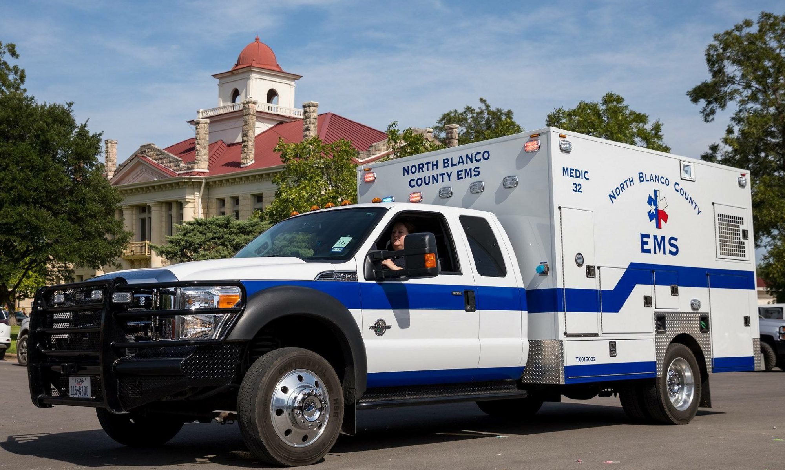
Mitigation
High Performance Emergency Medical Services (EMS) System
  Started in Blanco County 50 Years Ago
  Now provided by Blanco County ESD 1 and ESD 2
  Full-time Mobile Intensive Care Unit (MICU) Coverage
  Enhanced scope of practice
  Prevention efforts
Need for rapid transport of critically ill and injured patients with time sensitive conditions to comprehensive receiving facilities

Slide 4
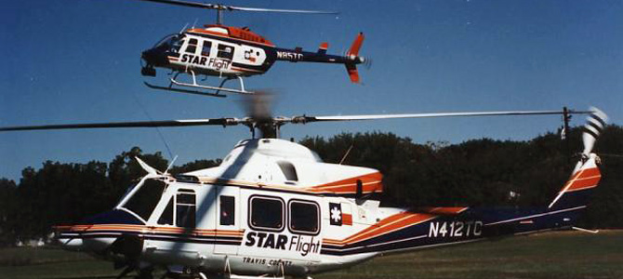
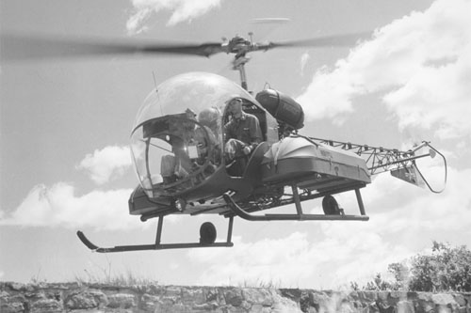
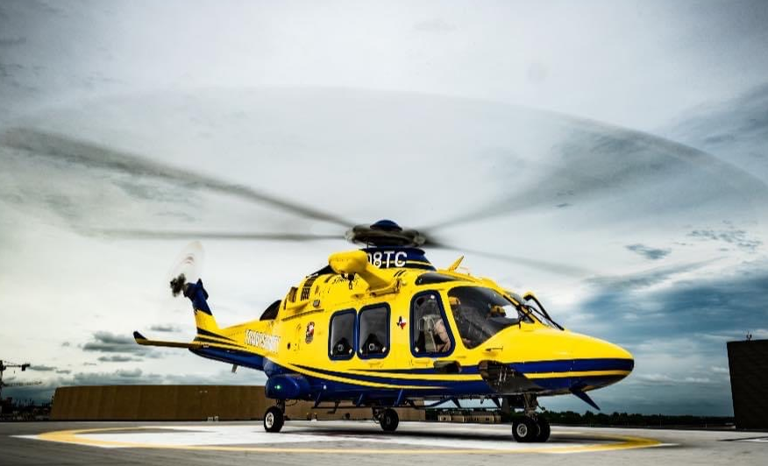
Helicopter Emergency Medical Services (HEMS)
Efficient method to rapidly move critical patients to comprehensive facilities, which has been in use since WWII, significantly reduced morbidity and mortality.
Helicopters staffed with a Pilot, Flight Nurse and Flight Paramedic transport patients in the aircraft to the hospital.
Locally, this results in a significant reduction in transport time to Level I Trauma Center:
Location | Avg Ground Transport | Avg Air Transport
Center of County | 52 Minutes | 13 Minutes
Furthest Points | 85 Minutes | 18 Minutes
Average Reduction of Transport Time = ~75%

Slide 5



A natural partnership to best serve our community…
Blanco County ESD 1
North Blanco County EMS
Blanco County ESD 2
Blanco County Fire/EMS
Travis County STAR Flight
Blanco County HEMS Provider

Slide 6
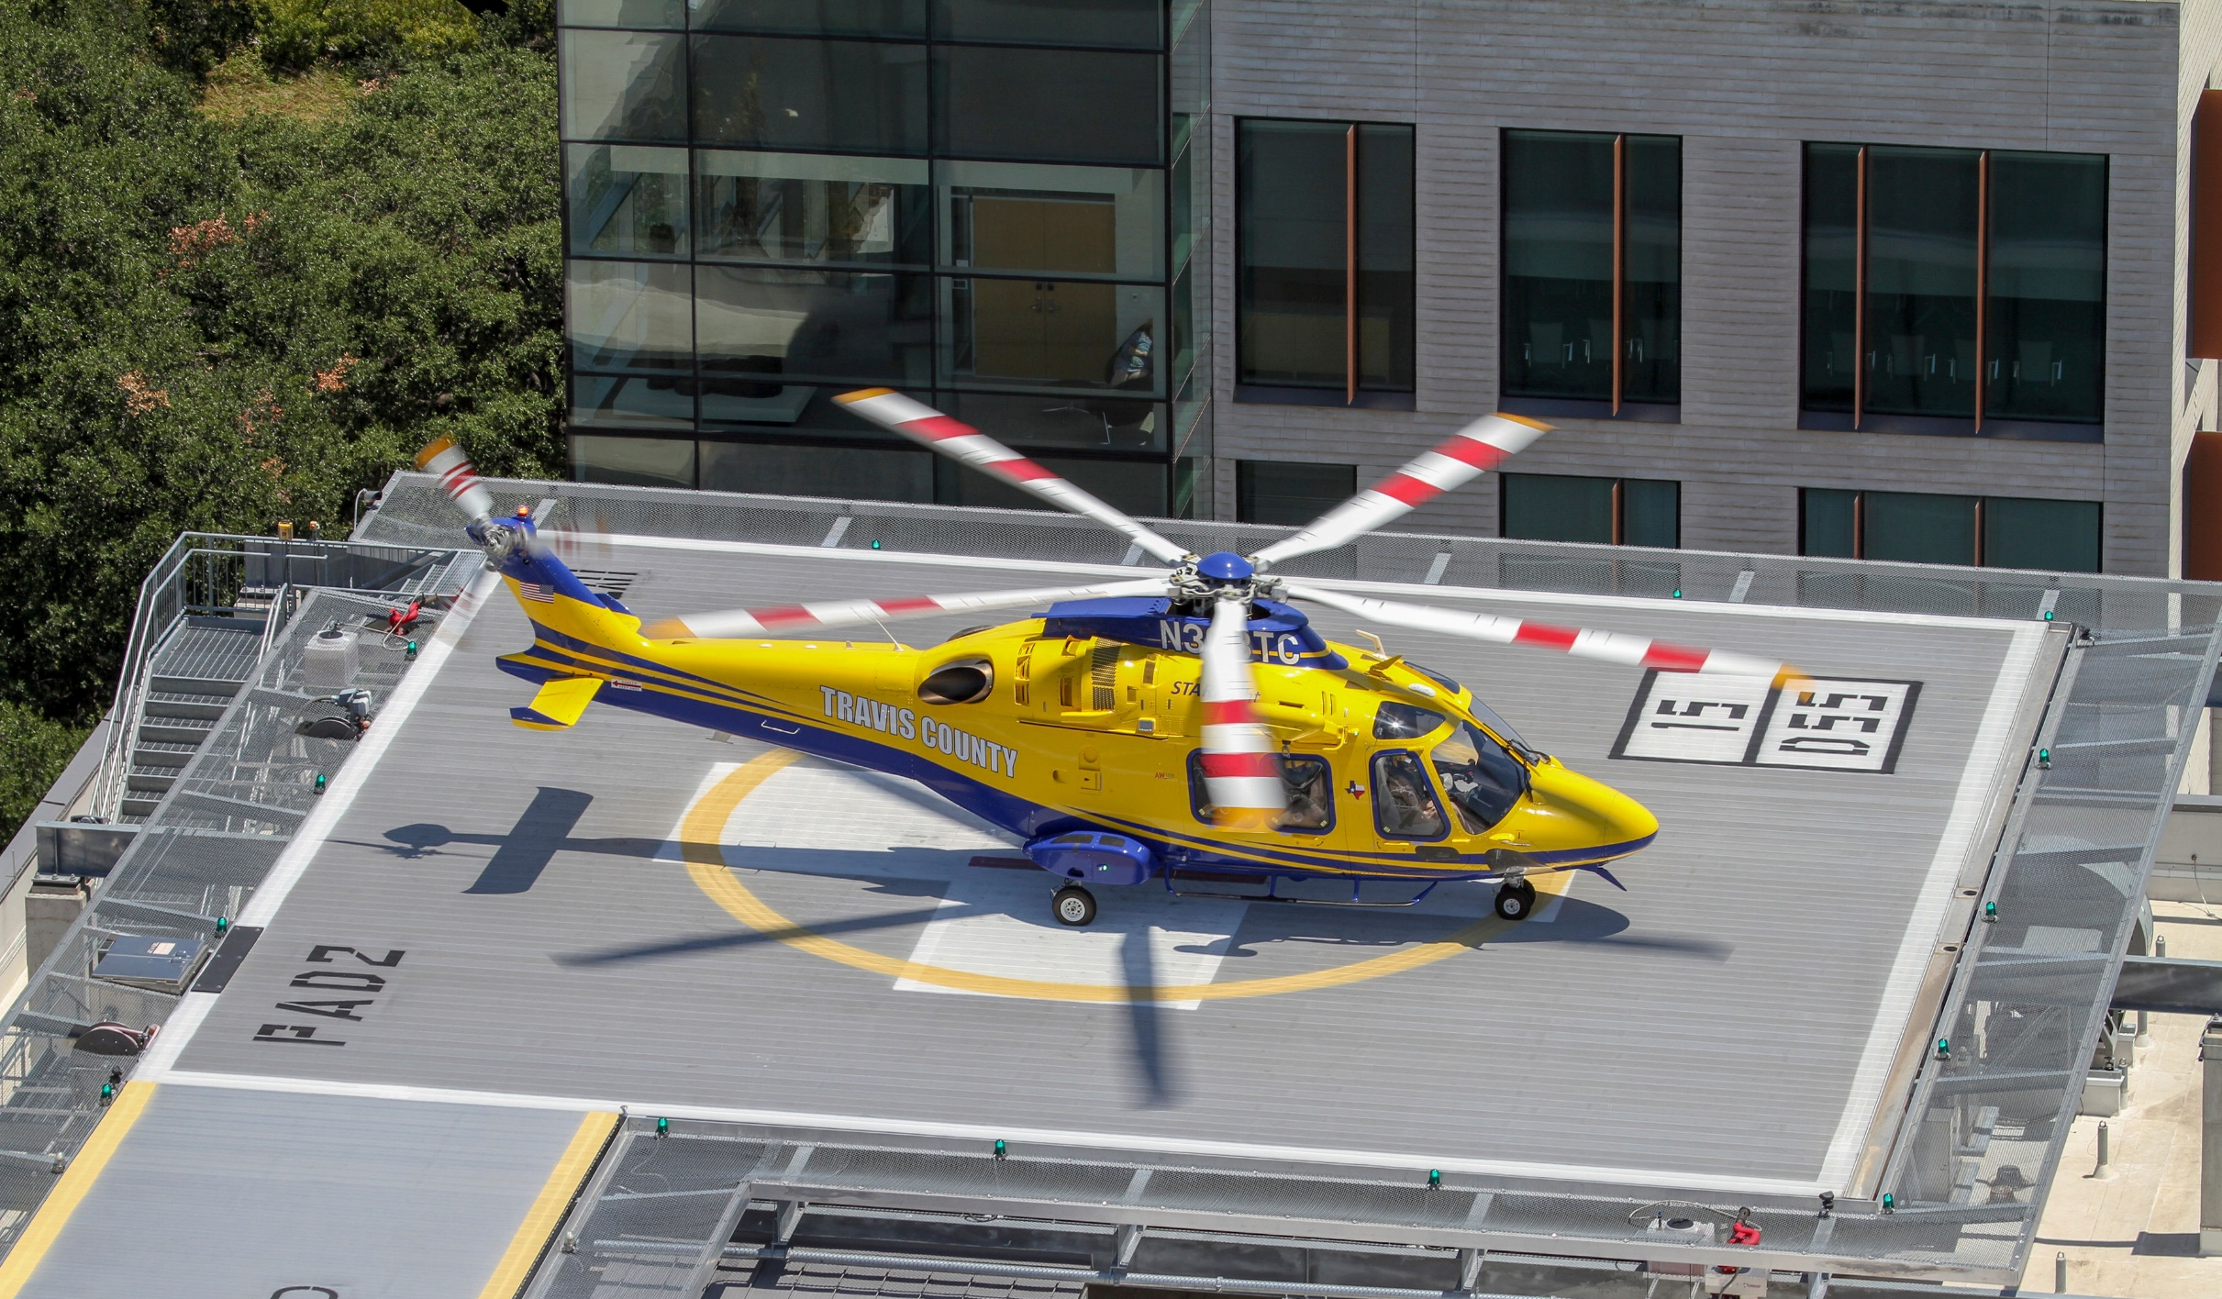

Disadvantages – Current Model
Benefits of HEMS Transport constrained by HEMS Response Times
HEMS Total Response & Transport Time=
Activation Time + Flight Time to Scene + Scene Time + Transport Time
Currently:
  Average Activation/Flight Time to Scene for Center of County = 26 min
Local EMS Providers must carefully evaluate each incident for the benefit of HEMS transport
Critically ill/injured patients currently experience prolonged transport times by ground when HEMS Response Times negate benefit
Prolonged transport times = Worse outcomes for critically ill/injured patients

Slide 7
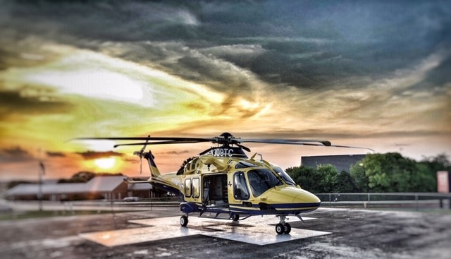
Solution – New Model
HEMS Programs have been transitioning over the years from a ‘centralized hub’ model where helicopters are based in urban areas and fly out to outlying areas to pick up patients and bring them back to a newer model where helicopters are based in more outlying areas, making them closer to the patients that need them most.
HEMS is an essential safety net for critically ill/injured patients in rural areas, so placing these resources closer to the patients that benefit most from them significantly reduces morbidity and mortality.

Slide 8
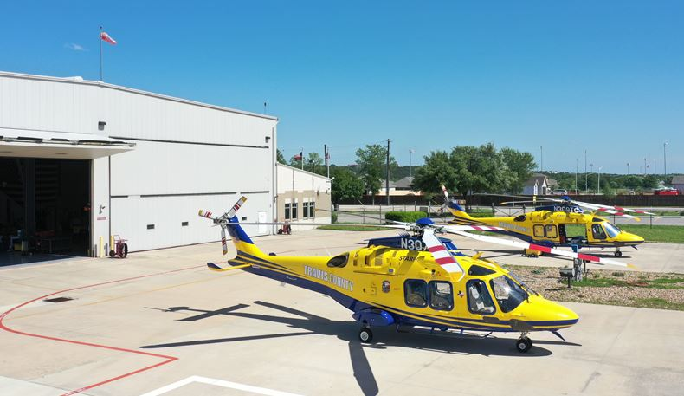
The Solution

Slide 9
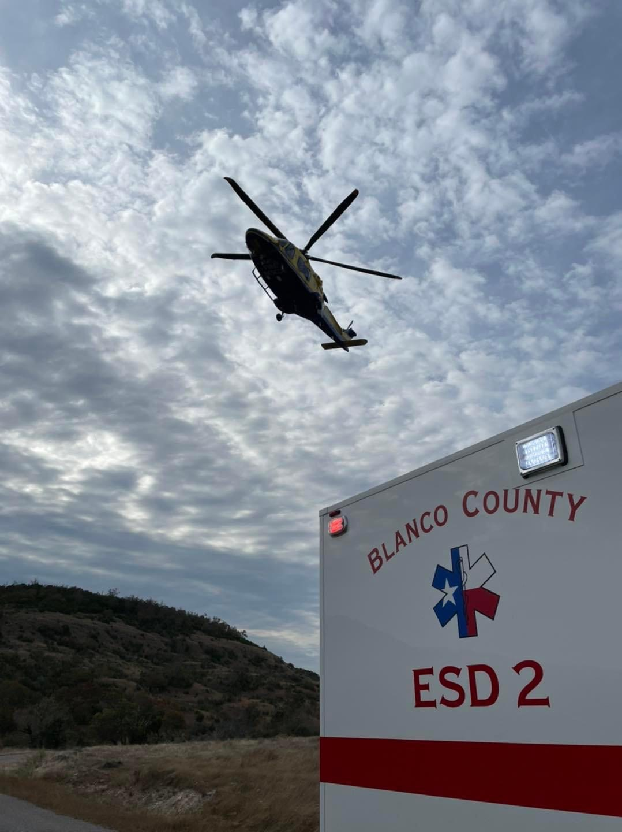
Proposed Project
Construction of a Station/Base in Northern Blanco County which would serve as a Helicopter Fixed Base of Operations as well as an EMS Station
The facility would be constructed to house the following:
  Travis County STAR Flight Aircraft and Personnel
  Blanco County ESD 1 EMS Apparatus and Personnel

Slide 10

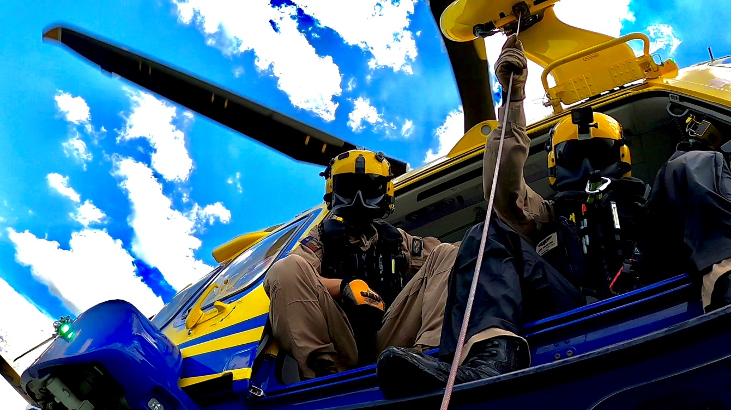
Travis County STAR Flight: Profile
Multi-Mission Public Safety Helicopter Program serving Travis County and the 17 Surrounding Counties of Central Texas
  Helicopter Air Ambulance
    911 Scene Response
    Critical Care Interfacility transport
  Search and Rescue/Hoist Operations
  Airborne Fire Recon and Suppression
  Law Enforcement Support
  Specialty Team Transport
Third oldest flight program in the state of Texas.
Started in 1985, 37 years of service to the community.
Only CAMTS accredited Public Safety flight program in
the United States

Slide 11
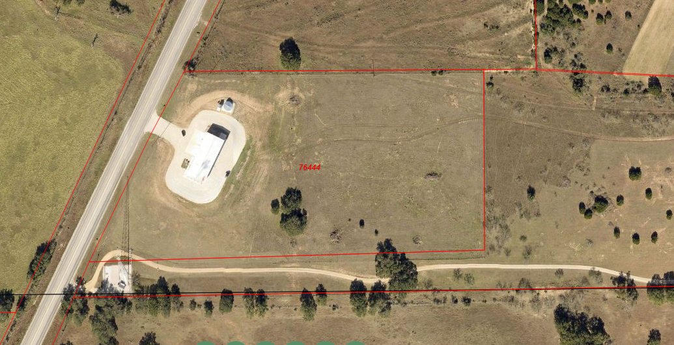
Site Selection
Round Mountain mutually selected as ideal site for program
Benefits of Site:
  Sufficient publicly owned land available (Currently owned by ESD1)
  Close proximity to Western Travis County
  Close proximity to common rescue locations
    Lake Travis
    Pedernales Falls
    Enchanted Rock
Due to aircraft cruise speeds, actual base location within County not significant
All of Blanco County has an average flight time of 10 minutes or less

Slide 12
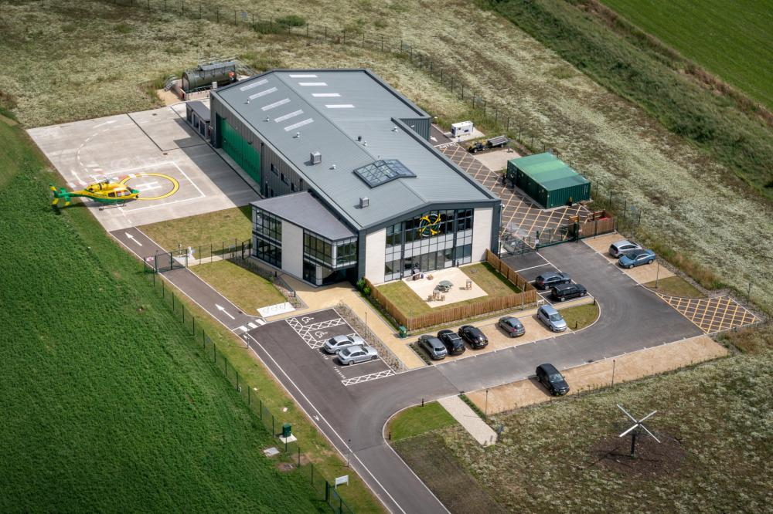
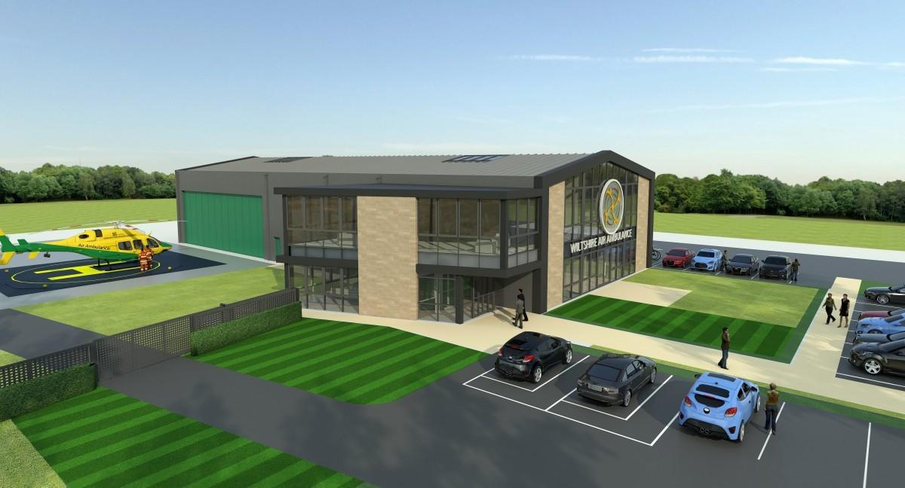
Project Scope
The proposed project would include the following:
  Helipad in compliance with FAA Regulations to safely land Leonardo AW169 in Single-Pilot Instrument Flight Rules (SPIFR) conditions
  Aviation Fuel Tank with 10,000 Gallon Capacity of Jet A Fuel
  Hangar capable of storing (1) Leonardo AW169 Aircraft and (1) Ambulance
  Station capable of housing (6) Personnel:
    (3) HEMS Personnel - Dedicated
    (2) EMS Personnel - Dedicated
    (1) HEMS or EMS Person

Slide 13
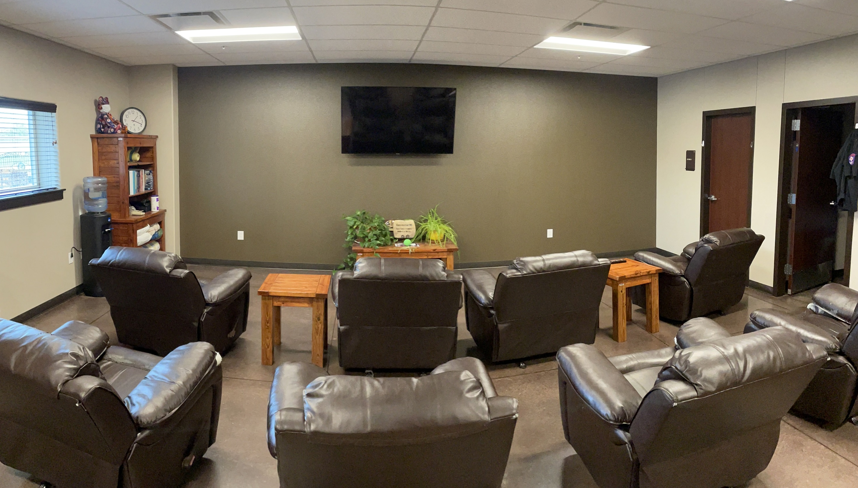
Project Scope
Station capable of housing (6) personnel
  Operations Office for Aviation and Ground Operations
  Crew Quarters (Bedrooms)
  Day Room
  Bathrooms/Showers (2)
  Kitchen
  Medical Supply Rooms for Aviation and Ground Operations
  Tool Room
  Decontamination Room
Estimated Size of Facility = 8,900 ft²
  Hangar / Apparatus Area = 4,400 ft²
  Conditions Space = 4,500 ft²

Slide 14
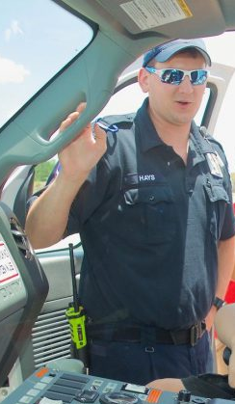
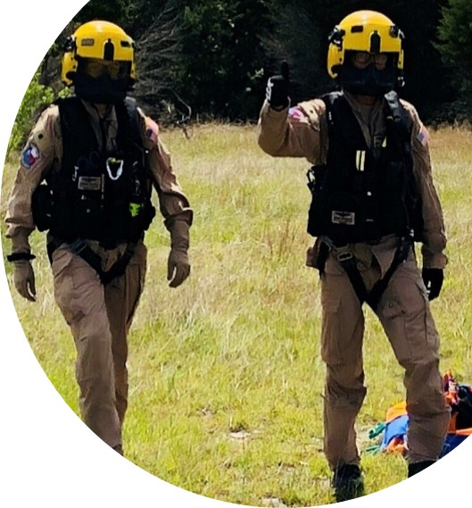
Facility Staffing Plan
Initial staffing plan concepts, subject to approval of respective management authorities:
  Travis County STAR Flight
    12-Hour Daytime Aircraft (1 Pilot, 1 Flight Nurse, 1 Flight Paramedic)
    Occasional overnight shifts
    Expanded coverage based on needs identified and resource/budget availability
  Blanco County ESD 1
    24-Hour Coverage with Single Paramedic Response Unit (“Squad”)
    Provides ALS First Response to Local Area (Round Mountain)
    Ensures ALS availability to all of Blanco County when EMS is at ‘Level 0’
    Provides supplemental ALS coverage (countywide) for high priority incidents
    Transition to 24-Hour MICU based on needs identified and resource/budget availability

Slide 15
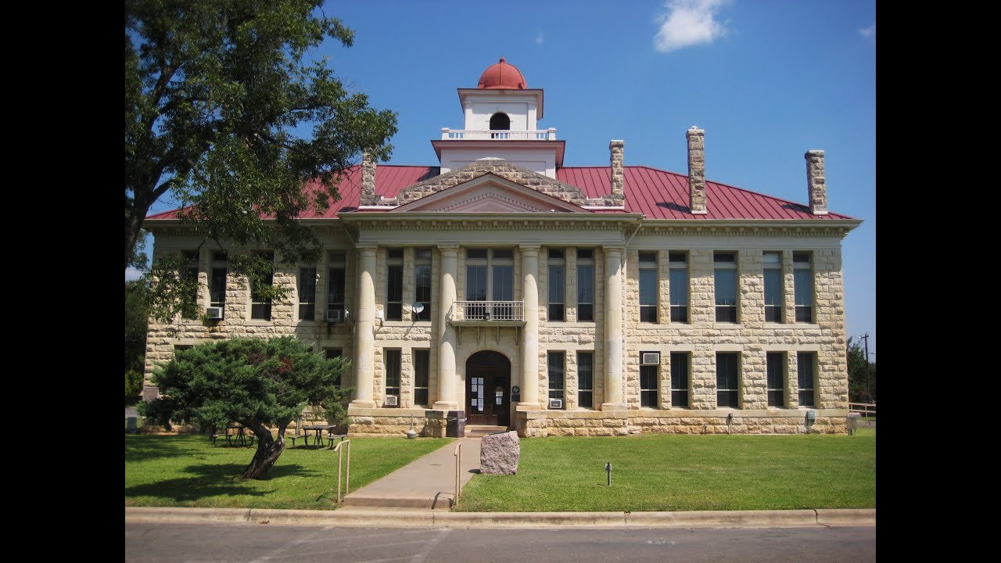
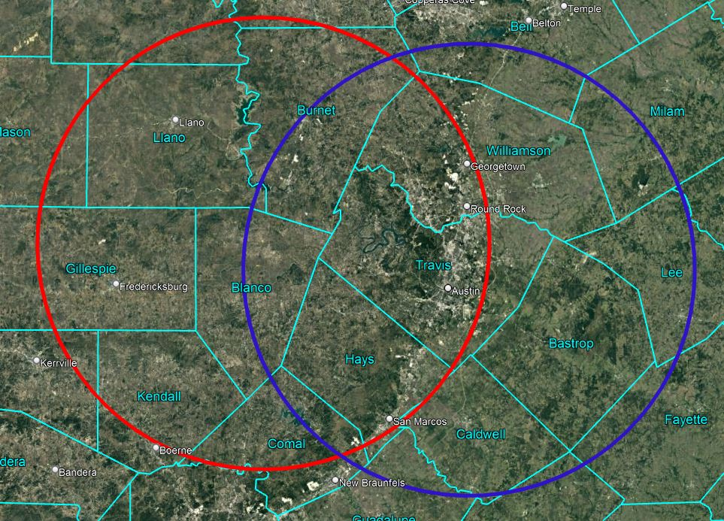
Benefits: Blanco County
Blue Circle- 15 min flight time coverage from STAR Flight hangar (Current model)
Red Circle- 15 min flight time coverage from proposed Blanco County hangar
Location | STAR Flight Hangar | Blanco County Hangar
Blanco | 15 minutes | 6 minutes
Johnson City | 14 minutes | 4 minutes
Round Mountain | 13 minutes | 0 minutes
Pedernales Falls | 11.5 minutes | 2 minutes
79% Average Reduction in Flight Times

Slide 16
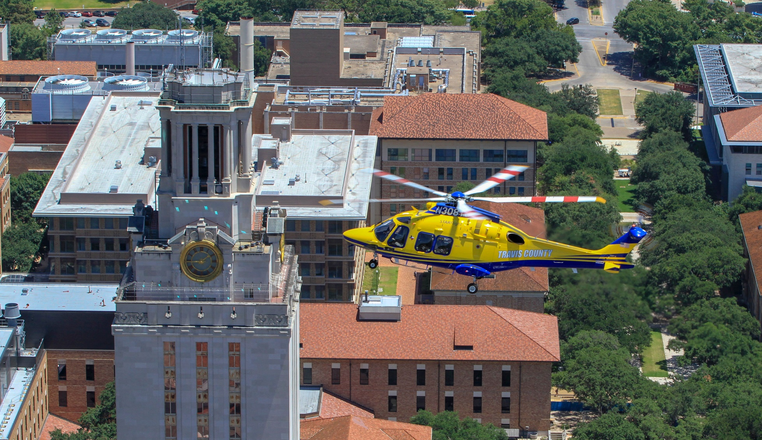
Benefits: Travis County
The creation of a western base of operations provides STAR Flight with faster, closer access to areas that generate significant utilization of the program.
  The ability to position a helicopter in this major service area shortens the flight-time required to reach patients.
  In addition, this western service area is typically busy during fire season. Having an airborne fire-fighting resource closer to these areas of need makes good sense
Moving a STAR Flight aircraft West provides decreased response time to our most frequent out of county response areas, while providing better or equal coverage to Travis County residents.
  Currently both STAR Flight aircraft are placed within 3 nautical miles from each other. Placing one aircraft further West significantly expands the reach of the STAR Flight program.
Blanco County has long been a valued customer of the STAR Flight program, keeping STAR Flight at the top of its emergency-call list for all air-ambulance needs.

Slide 17
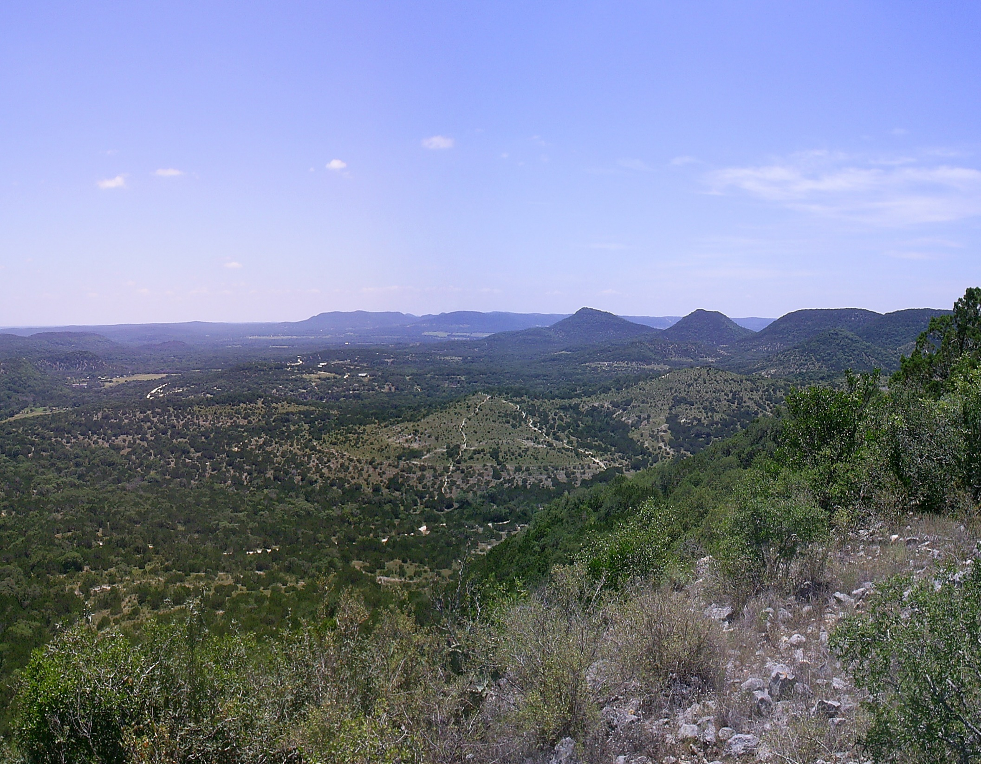

Benefits: Texas Hill Country
Travis County STAR Flight serves more than just Travis and Blanco counties
STAR Flight serves Travis County and the surrounding 17 counties of Central Texas
Project brings this critical asset closer to several of our neighbors, bringing the same benefits to them:
  Burnet County
  Llano County
  San Saba County
  Lampasas County
  Gillespie County
  Hays County
  Comal County

Slide 18
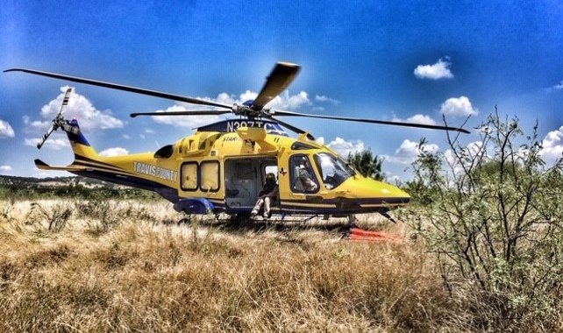
Interlocal Agreement Contingencies
This interlocal agreement has two important requirements which the ILA is contingent upon:
  Blanco County obtaining adequate financing on acceptable terms and conditions for the Project no later than December 31, 2022
  Blanco County obtaining title in fee simple to the Property no later than December 31, 2022
If both of these requirements are not met by the deadline, the ILA will is terminated as of January 1, 2023

Slide 19
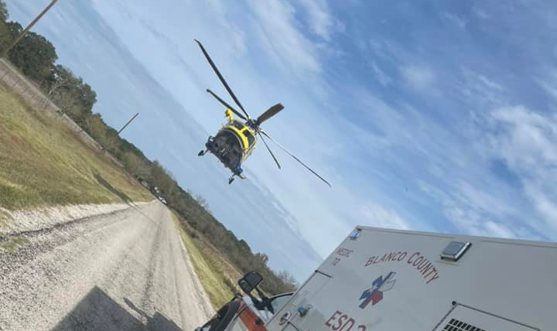

Summary: IHI Triple Aim
The IHI Triple Aim is a framework developed by the Institute for Healthcare Improvement that describes an approach to optimizing health system performance. New designs must be developed to simultaneously pursue three dimensions, which is called the “Triple Aim”:
  Improving the patient experience of care (including quality and satisfaction);
  Improving the health of populations; and
  Reducing the per capita cost of health care.

Slide 20
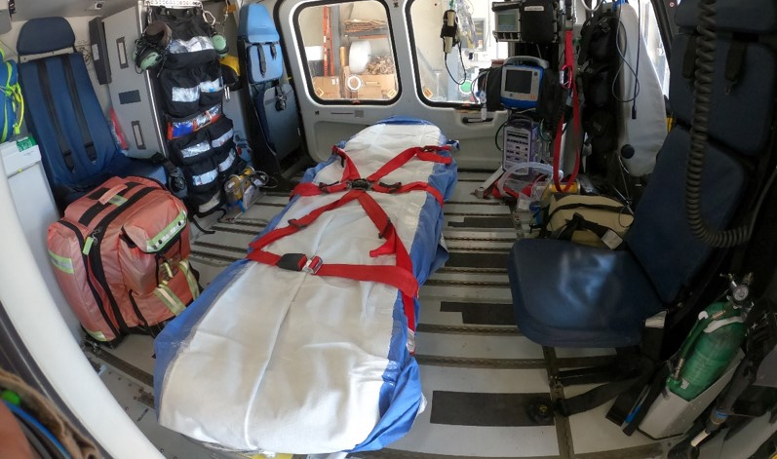
Summary: IHI Triple Aim
Population Health
  Reduces morbidity/mortality
  Reduces disparity – rural patients can access comprehensive healthcare in the same amount of time as an urban patient could
Experience of Care
  Reduced transport times greatly improves patient satisfaction
  Provides added comfort to consumers
Per Capita Cost
  Partnership is a cost-effective solution compared to other solutions
  Provides access to a governmental/public air medical provider, which delivers service at a fraction of the cost of the private air medical industry, with much more advantageous billing methodologies, reducing consumer cost

Slide 21
Questions?

